Slide 1
Ismet Selimovski
DATA SCIENCE – FINAL PROJECT

Slide 2
Introduction/Business Problem
1.1 Scenario and Background
I currently live and work in Skopje, the capital of Northern Macedonia. In the environment where I live I have all the necessary elements for a quality life. What was interesting to me was to compare the prices of renting a place to live in downtown Manhattan, where I would enjoy the benefits that I currently enjoy in Skopje.
1.2 Problem to be resolved:
The goal is to find an apartment in Manhattan that will have similar features and benefits to the one I am staying in Skopje.
Criteria:
- Apartment with min 2 bedroom with monthly rent < $5000 per month
- Area with ammenities and venues

Slide 3
1.3 Interested Audience
The target group of this project would be all those who live in one of the capitals in countries across Europe and who would like to move and live in Manhattan.
DATA SECTION
In order to be able to make an appropriate conclusion regarding our challenge, we need appropriate data that will serve as a basis for further analysis. We specifically need a list of apartments near Manhattan with data on the number of rooms, beds, location, address, etc. The list of required data has already been worked on in the previous laboratory exercises within the course and as such has been used here as well.

Slide 4
Methodology section
The strategy is based on using the data above to obtain at least a few candidate rental apartments in Manhattan. By using visual approach and maps we will be able to more easily represent these locations and make an appropriate selection
By processing the data we will be able to answer the main questions that interest us:
cost of available rental places
venues of the two best places to live
other interesting statistical data

Slide 5
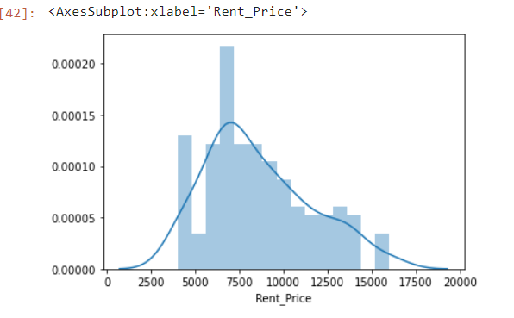

Slide 6
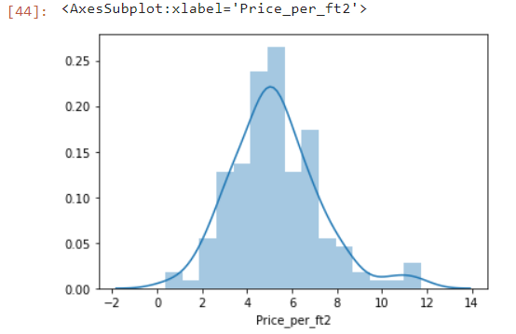

Slide 7
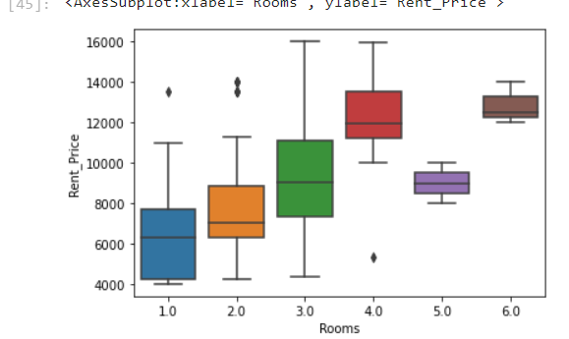

Slide 8
Conclusion
From the analysis we can conclude that there are suitable apartments that meet the conditions we set ourselves at the beginning.
In the end I would like to say only words of praise for the creators of the course because they allowed me to learn many new things in this domain which is still very new and unknown.

